Slide 1
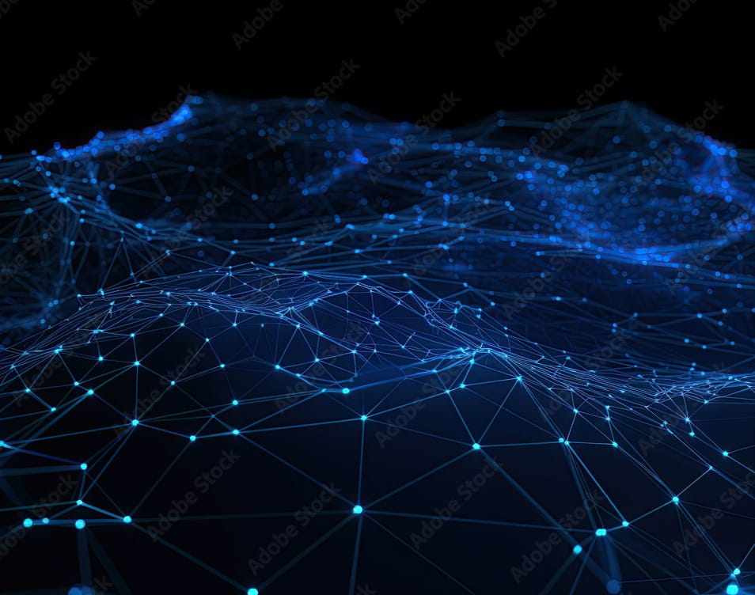
HACK-A-BIT
TEAM - TECH VISIONERS 2.o
PRESENTS
NeuroVisionAI: TumorMapperNet

Slide 2
Problem Statement
Our aim is to develop and deploy NeuroVisionAI: TumorMapperNet, an advanced deep learning model, to accurately detect and segment brain tumors in MRI scans. By leveraging cutting-edge neural vision technology, our goal is to provide healthcare professionals with a reliable and efficient tool for precise tumor mapping, enabling early diagnosis and effective treatment planning. Ultimately, our aim is to enhance diagnostic capabilities in healthcare and improve patient outcomes.

Slide 3
ABOUT MODEL
"NeuroVisionAI: TumorMapperNet" is an advanced deep learning model designed for precise detection and segmentation of brain tumors in MRI scans. Leveraging cutting-edge neural vision technology, the model accurately identifies tumor regions, aiding in early diagnosis and treatment planning. Its sophisticated architecture, combining convolutional and recurrent neural networks, ensures high accuracy and efficiency in tumor mapping. NeuroVisionAI empowers medical professionals with a reliable tool for improved patient care, contributing to enhanced diagnostic capabilities in healthcare.

Slide 4
Importing Libraries and Packages
1. os
2. numpy
3. pandas
4. matplotlib.pyplot
5. seaborn
6. zipfile
7. cv2
8. skimage.io
9. tensorflow
10. tensorflow.keras.Sequential
11. tensorflow.keras.layers
12. tensorflow.keras.optimizers
13. tensorflow.keras.initializers
14. tensorflow.keras.utils
15. tensorflow.keras.callbacks
16. tensorflow.keras.backend
17. random
18. glob
19. sklearn.preprocessing.StandardScaler
20. sklearn.preprocessing.normalize
21. IPython.display

Slide 5
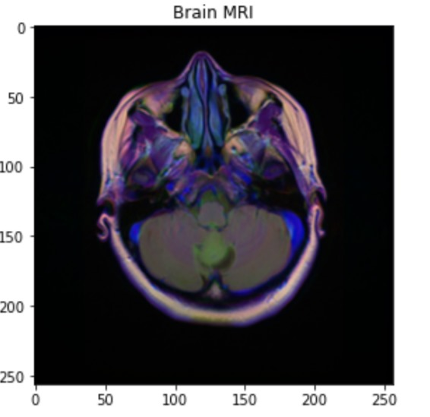
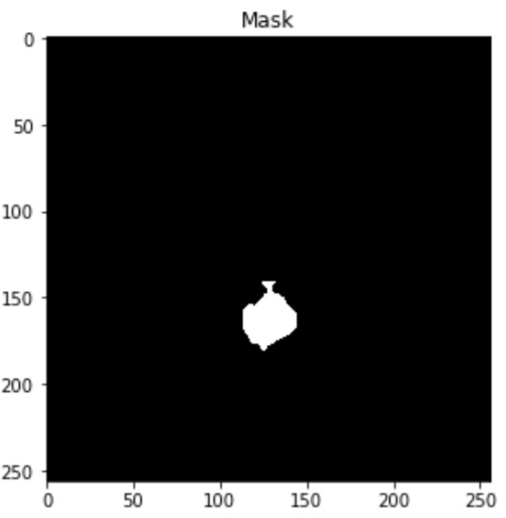
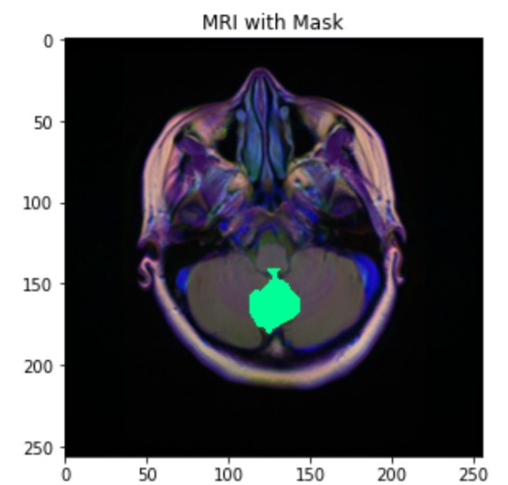
Dataset
This dataset comprises brain MR images paired with manual FLAIR abnormality segmentation masks. The data is sourced from The Cancer Imaging Archive (TCIA) and involves 110 patients from The Cancer Genome Atlas (TCGA) lower-grade glioma collection. Each patient's data includes a FLAIR sequence and genomic cluster information. The tumor genomic clusters and patient data are provided in the data.csv file.

Slide 6
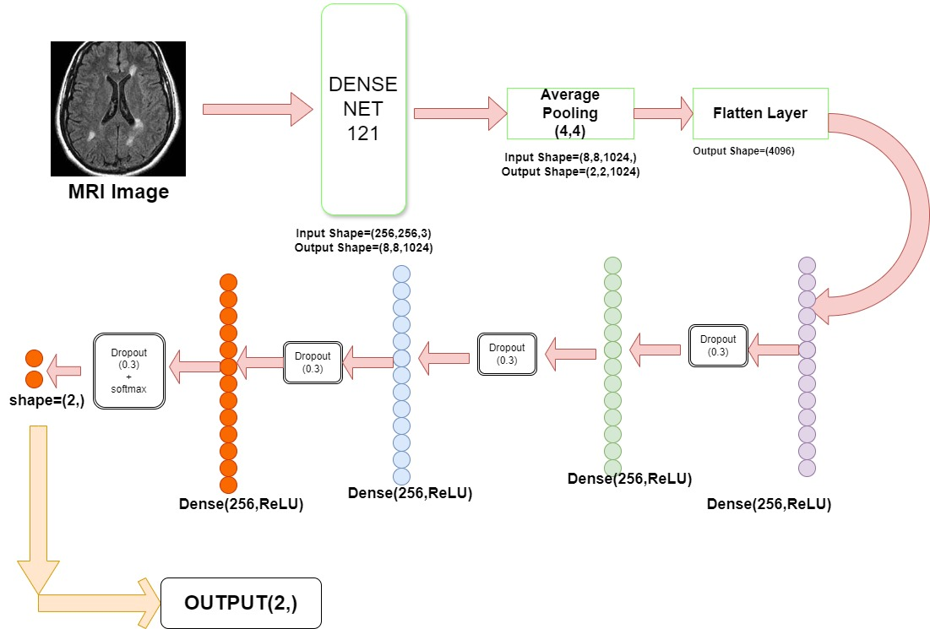
Structure of our NeuroVisionAI Part : 1

Slide 7
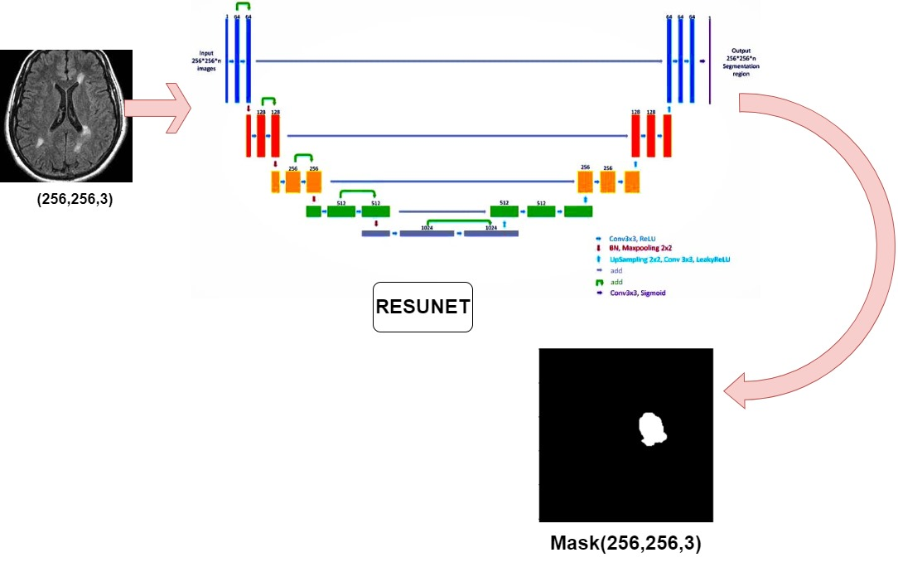
Structure of our NeuroVisionAI Part : 2

Slide 8
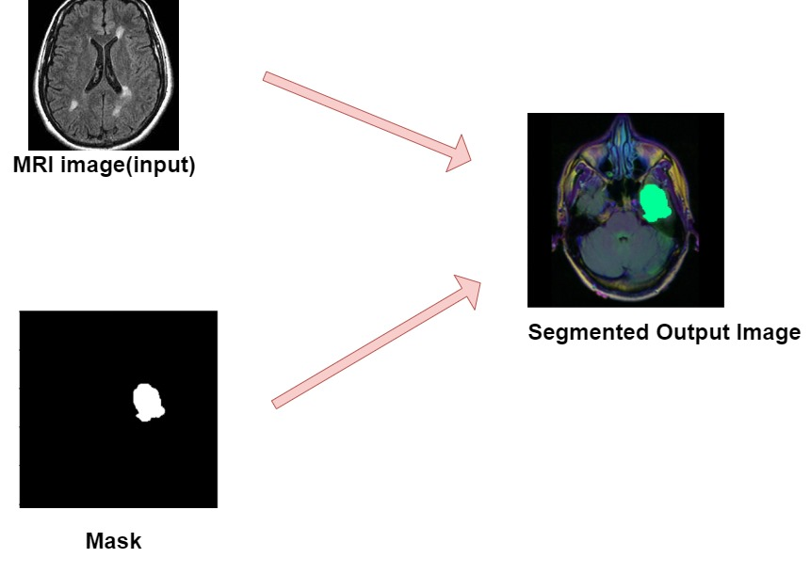
Structure of our NeuroVisionAI Part : 3

Slide 9
Our Target :
Achieving a remarkable 99% accuracy, precision, recall, and f1-score in our MRI tumor segmentation project marks a significant milestone. This advancement holds immense promise for India's "ATMANIRBHAR BHARAT" initiative, aiming to foster self-reliance and indigenous development. By employing cutting-edge deep learning and artificial intelligence technologies, our project equips local medical practitioners with a robust tool for precise and efficient tumor segmentation in MRI scans. This reduces reliance on external expertise and fosters innovation in healthcare technology. Empowering healthcare providers with such advanced tools not only enhances patient care but also stimulates indigenous research and development in critical healthcare domains. Our project exemplifies India's capability to lead in healthcare innovation and contributes to the nation's journey towards self-sufficiency and technological advancement.

Slide 10

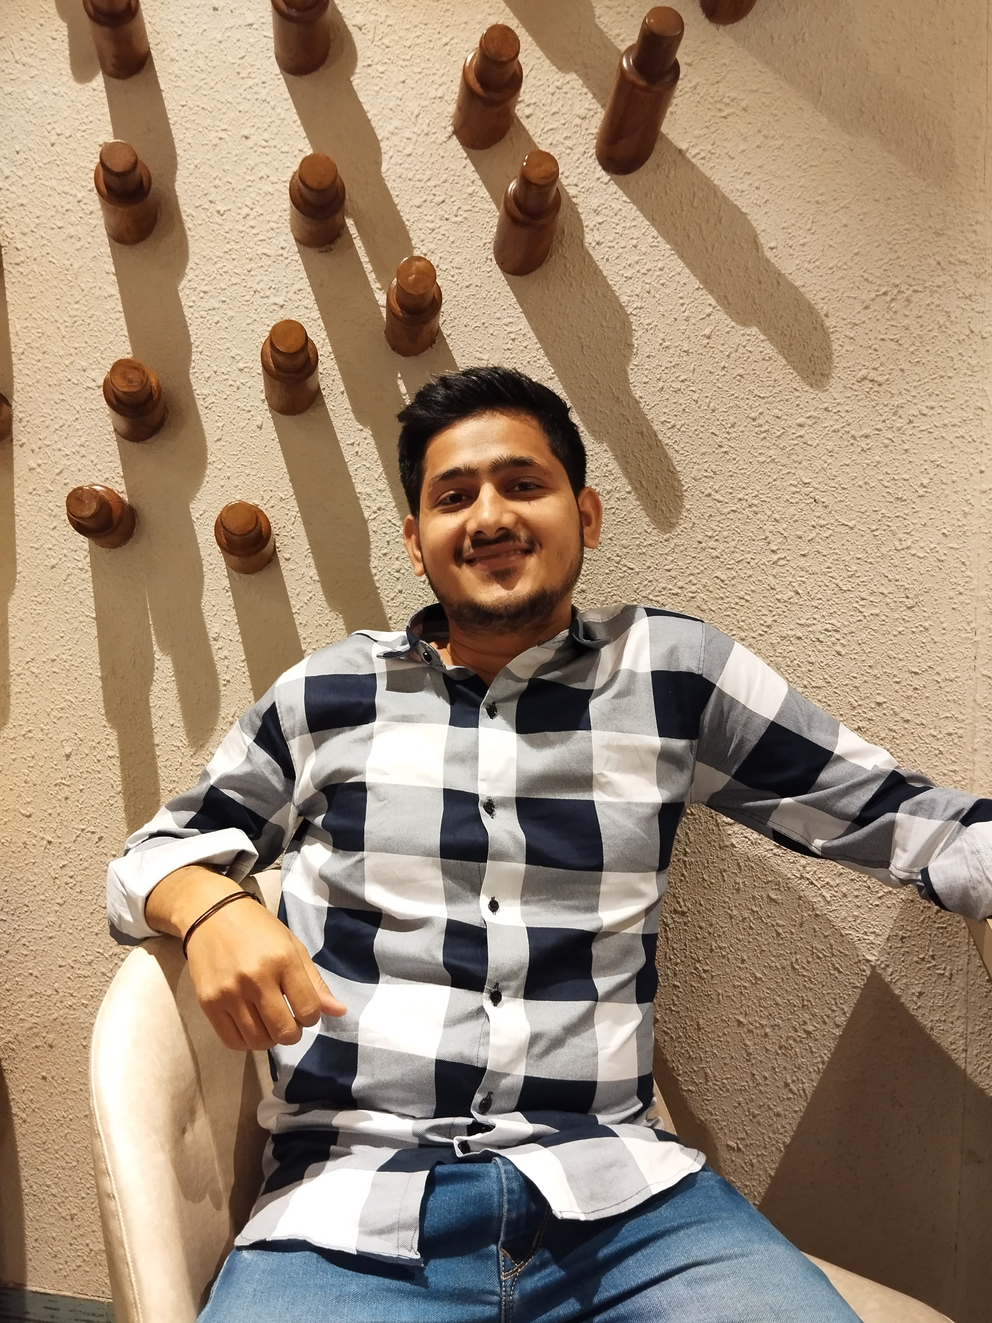

TECH VISIONERS 2.O
Nishant(Team Leader)
Vivek Kumar
Ayush Shaurya Jha
IIIT Ranchi
IIIT Ranchi
IIIT Ranchi

